Slide 1
Automated Winch System
for Underwater Sampling
Final Presentation - Team 12
Philip Schmitz, Adam Chapman, Funakoshi Silva, Nick Alfano,
Parwesh Rallapalli, Paul Hanvey, Yacer Mirza
Facilitator: Dr. Sunil Chakrapani
Sponsor: MSU ECE Smart MicroSystems Lab
Notes:
Nick

Slide 2
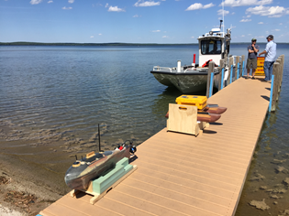
Introduction
Problem Statement: GPS-based location tracking for autonomous surface crafts (ASCs) are unable to track underwater depth while surveying and sampling of lakes and rivers.
Proposal: Develop an automated winch to lower an underwater system to a given depth upon arriving at a location
Source: MSU ECE SML
Notes:
Phil

Slide 3
Introduction
Project Objectives:
To develop a winch system that can lower a system to any desired depth underwater based on the feedback it receives from a pressure sensor
Power distribution
Communication
Controls
Data Cable Wiring and Sensors
Team Resources:
4 EE’s primarily working on the hardware
3 CpE’s primarily working on the software
Notes:
Phil

Slide 4
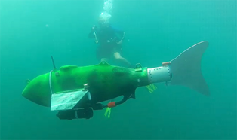
Background
Research at the Smart Microsystems Laboratory (SML) focuses on electroactive polymer sensors and actuators, modeling and control of smart materials, soft robotics, bio-inspired underwater robots, and underwater mobile sensing
Many of the previous projects at SML focus on robotic fish.
Notes:
Paul Hanvey

Slide 5

Background
United States Geological Survey (USGS) implants fish with acoustic tags [1]
Monitor behavior of fish
Ping tags using a transmitted and receiver
Current Active Tracking methods are outdated
Researchers must hold receivers manually
Source: USGS
Notes:
Paul Hanvey

Slide 6
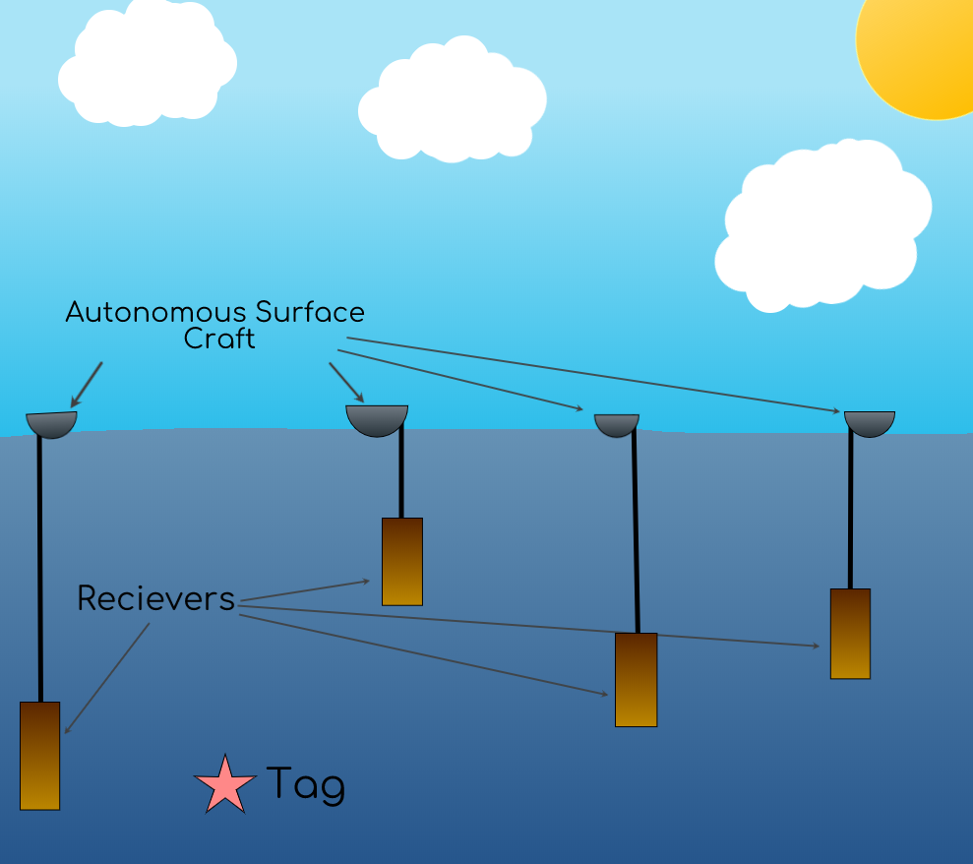
Background
SML is developing ways to use mobile robots for automated fish tracking
Time Difference of Arrival (TDOA) Localization
Multiple receivers (4) at known location and depths
Notes:
Paul Hanvey

Slide 7
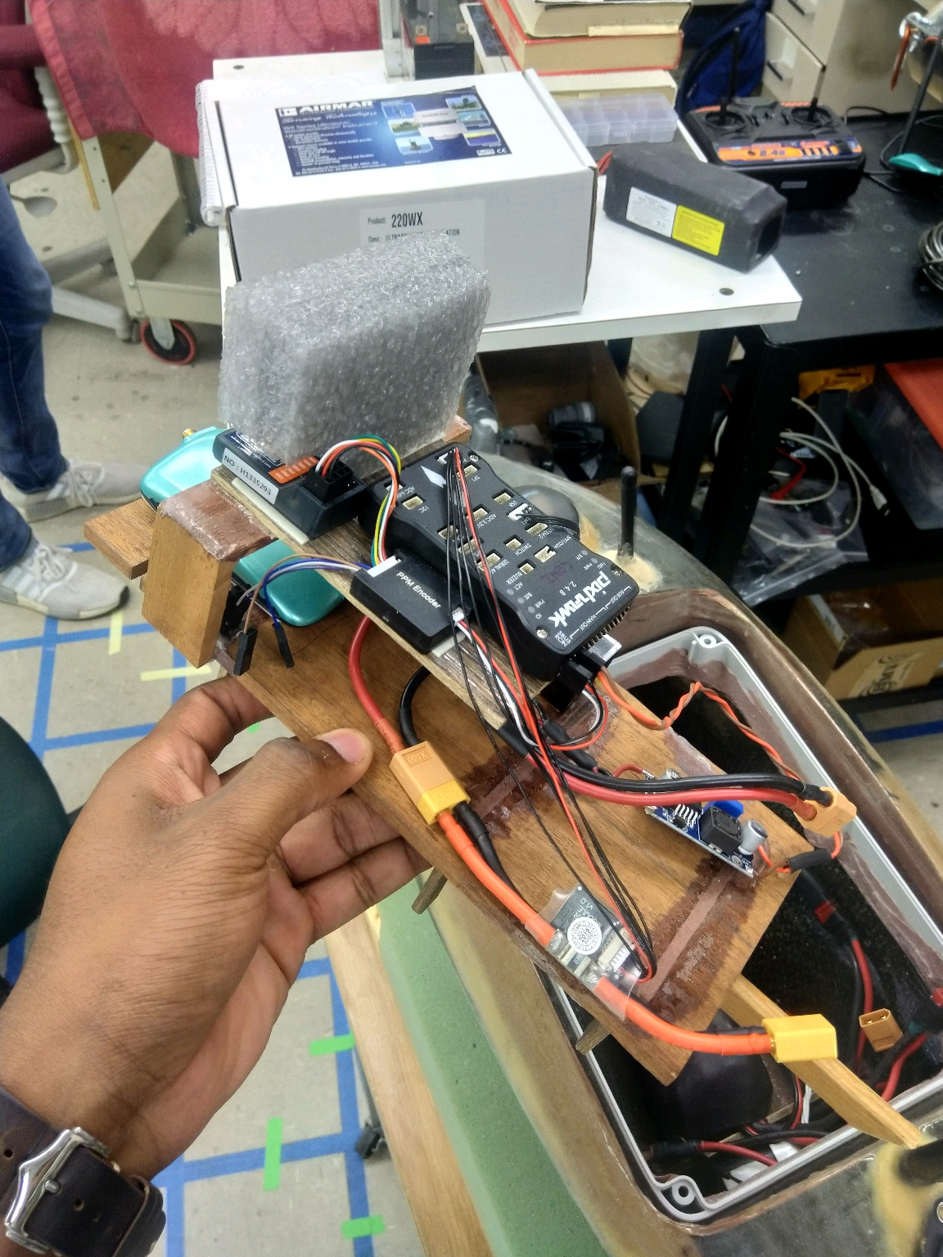
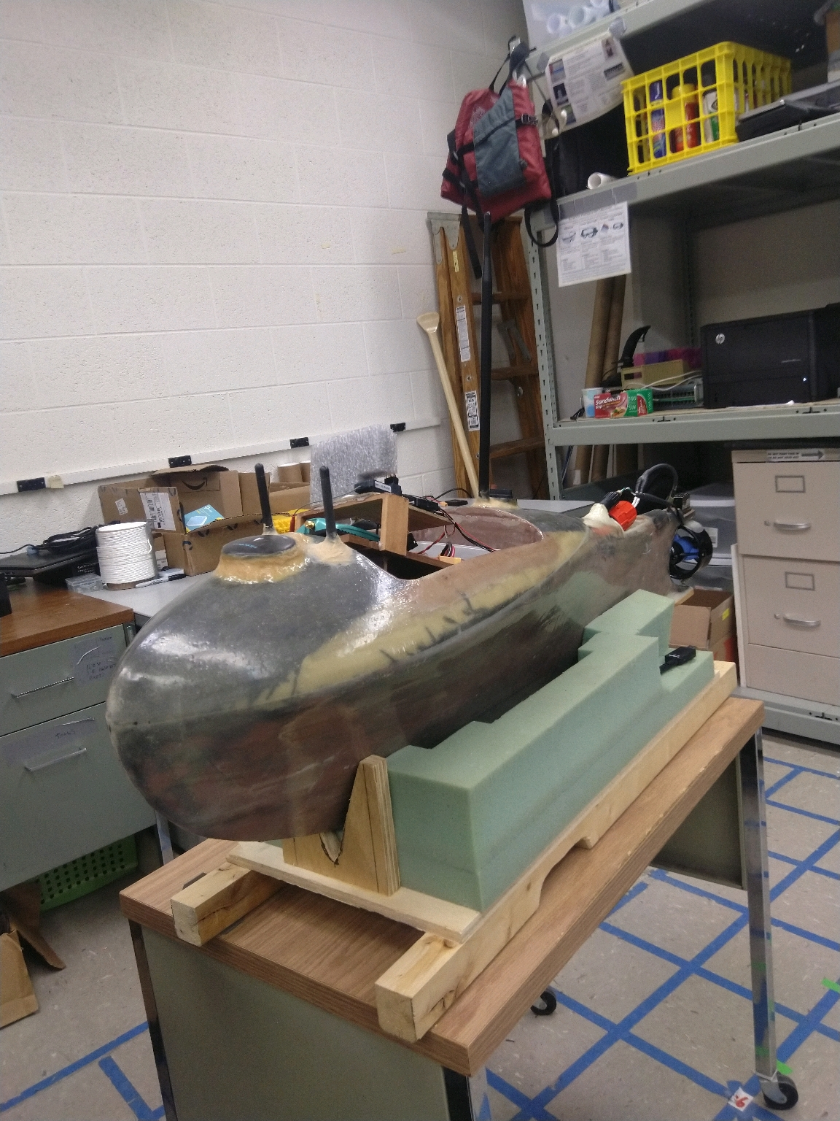
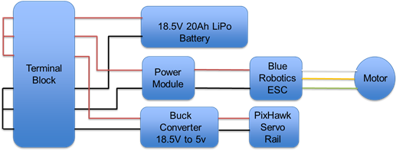
Prior Work
Carbon fiber and fiberglass hull
Self righting and fully submersible
Blue Robotics T200 Thruster connected to 18.5V rail using Blue Robotics ESC
PixHawk controller with GPS Tracking powered by PixHawk Power Module
18.5V LiPo battery connected to a 6 position terminal block
Notes:
Yacer M

Slide 8
Objectives
Power Distribution
Design, fabricate and test a PCB Power Distribution Board that is capable of powering each device properly
Communication
Establish communication between components such as the Raspberry Pi, the PixHawk, the Electronic Speed Controllers (ESCs), the winch and the host computer using X-Bee
Controller
Control operations of the watercraft: hardware failsafe, deploy sensor, monitoring sensor data and notifying host computer of events
Data Cable
Replacing the standard rope that comes on the winch with a reinforced, waterproof cable that can send/receive data over the required distance (50ft)
Notes:
Nick

Slide 9
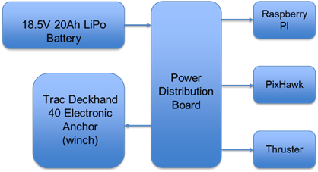
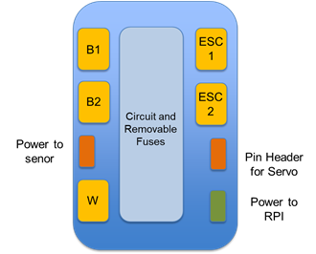
Technical Approach - Block Diagram
Power distribution has built in connectors and current protection (fuses)
18.5V Battery get distributed as four voltages: 18.5V (bypass), 12V (winch), 5V (RPI), adjustable 5-7V (servo rail)
Notes:
Adam Chapman

Slide 10
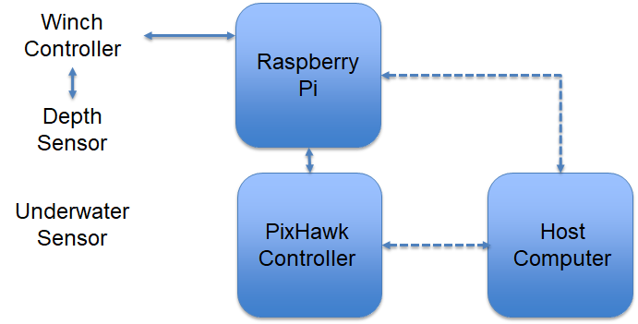
Implementation Details
Raspberry Pi will interface with depth sensor to control relay on PCB
Location data/state will be sent to RPI from PixHawk
Host Computer will communicate with both controllers using XBee radio
Notes:
Parwesh Rallapalli

Slide 11
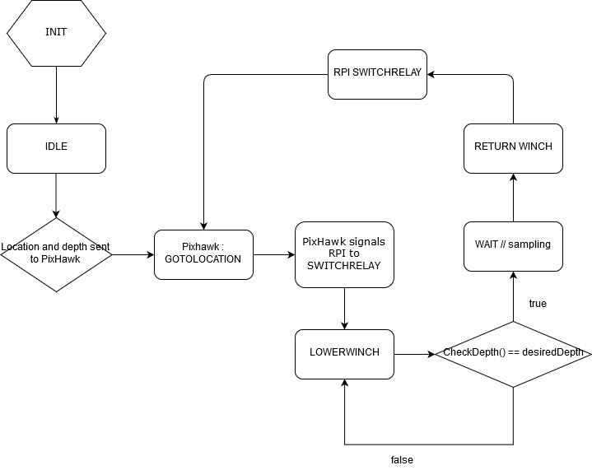
State Machine Flowchart
Notes:
Parwesh Rallapalli

Slide 12
Power Distribution Board
Requirements: Needed to have two 18.5V inputs, two 18.5V outputs, one 12V output, one 7V output and one 5V output. Needed to protect the batteries with fuses. Needed to be compact.
To meet these requirements the board would have to utilize DC to DC converters to appropriately power all of our devices. To do this we used 3 buck converters each powering a component. The final dimensions for the board were 3 inches by 3 inches, this will fit nicely in our case.
Notes:
Nick

Slide 13
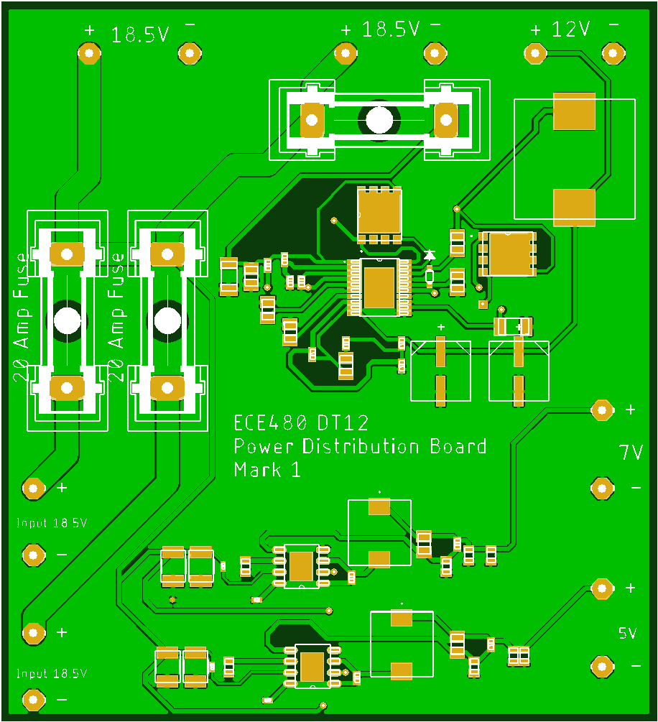
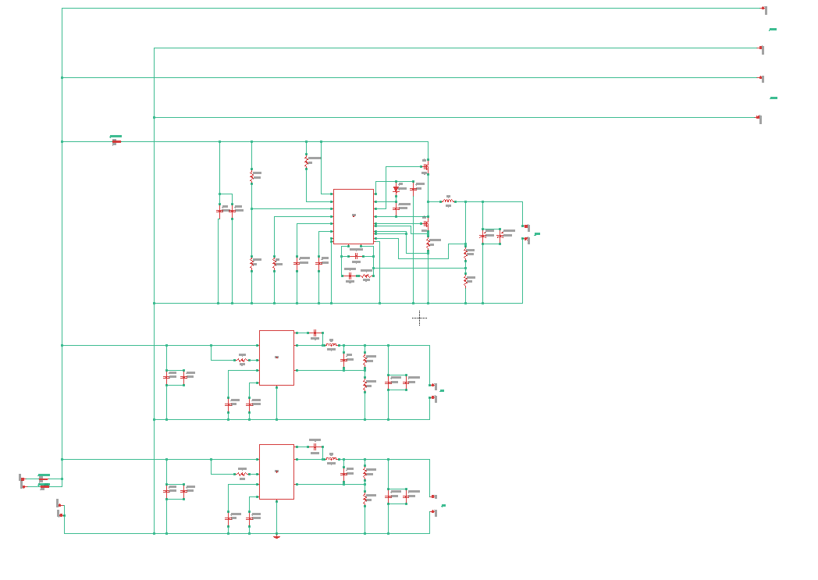
Power Distribution Board

Slide 14
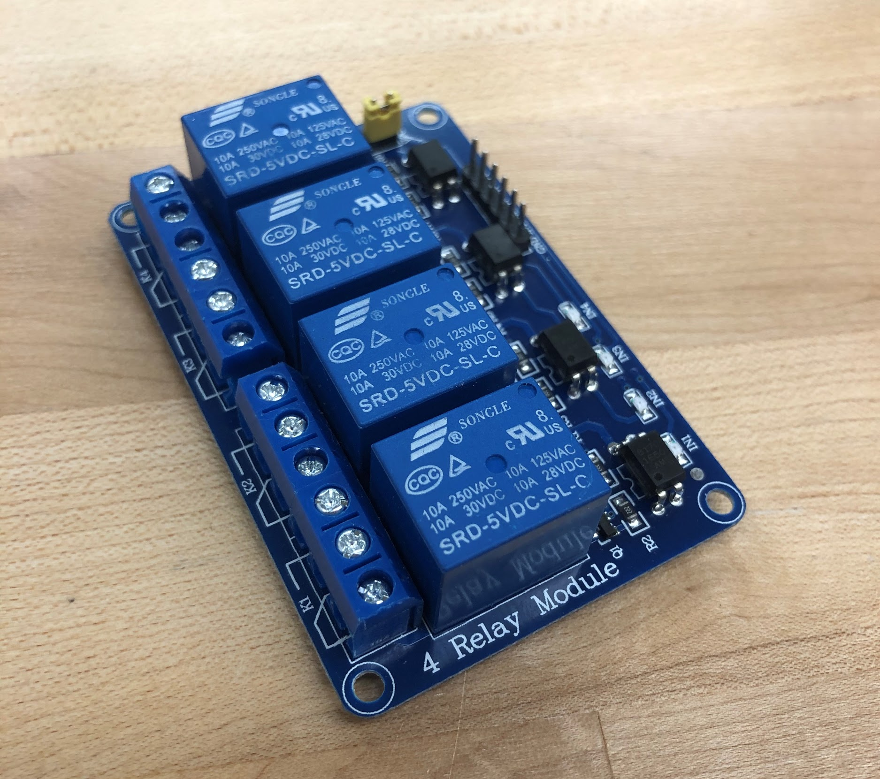
Controlling the Winch - Relay
Problem: The Minn Kota DeckHand winch that was provided by the Smart MicroSystems Lab was meant to be operated by hand. Since our watercraft would be unmanned, this became an issue
Solution: A 4 channel relay was used to replace the 3 position switch that came standard on the winch. A 4 channel relay would allow us to run the electric motor one way using two of the relays and the other way using the remaining two relays.
Notes:
Nick

Slide 15
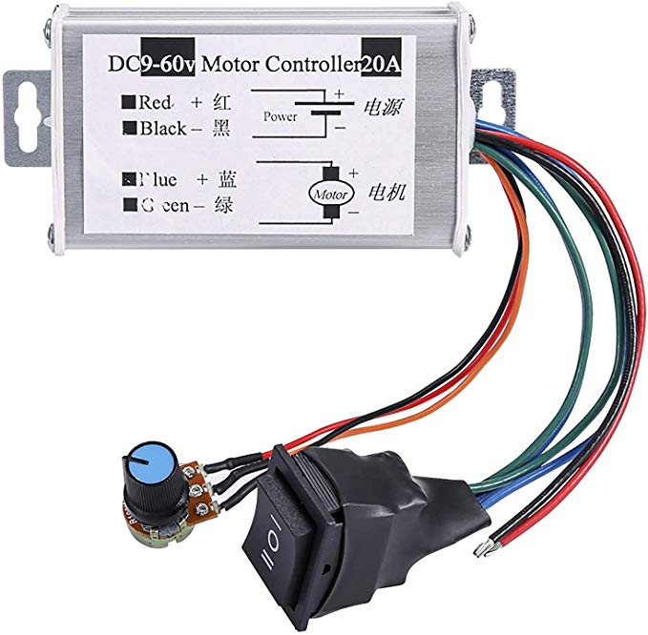
Controlling the Winch - Speed Controller
Problem: The winch could only be turned on and off, there was no control over the speed. Full power made the winch run too fast. The team concluded that this would negatively impact the sensors ability to accurately sense the depth.
Solution: We used a PWM speed controller with an adjustable POT to have full control over the speed of the winch. We believe this led us to more accurate results
Notes:
Nick

Slide 16
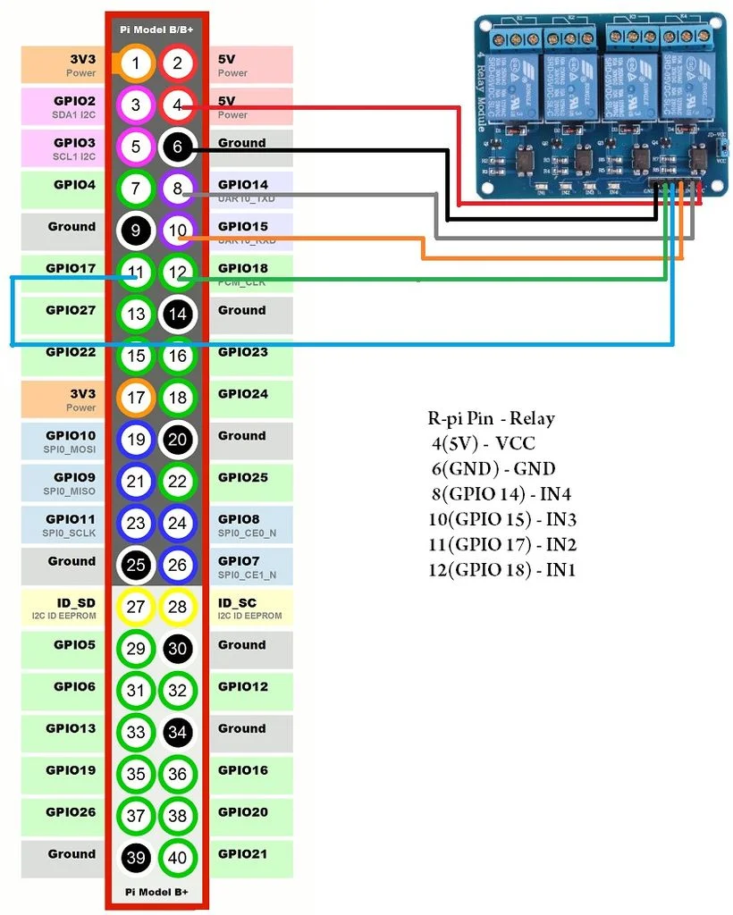
Winch Automation - Sensor Control
Problem: Automation of the winch in order to allow autonomous behaviour given a depth value.
Solution: We used the microcontroller peripherals, and supporting functions to generate logic to our system.
Notes:
Funakoshi
Will explain about how the source code, communicates with the relay to move winch automatically
-Supporting functions
- GPIO usage

Slide 17
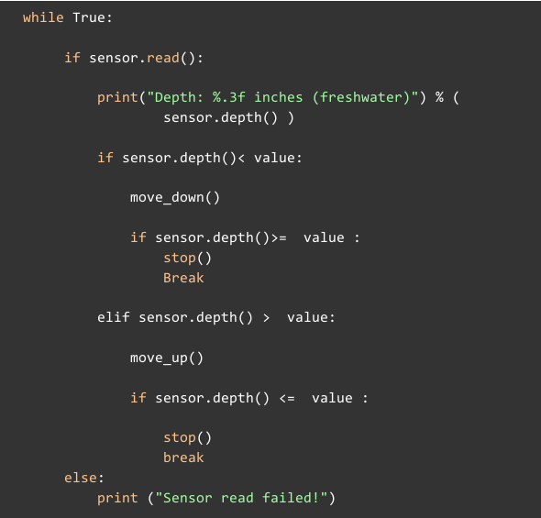
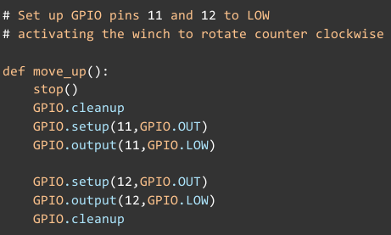
Winch Automation - Sensor Control
Notes:
Funakoshi
Usage of sensor library used by the sensor
-Supporting functions

Slide 18
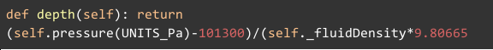
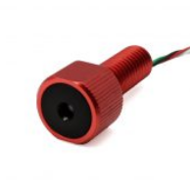
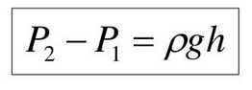
Winch Automation - Sensor Control
Pressure vs Depth in Fluid
Notes:
Funakoshi

Slide 19
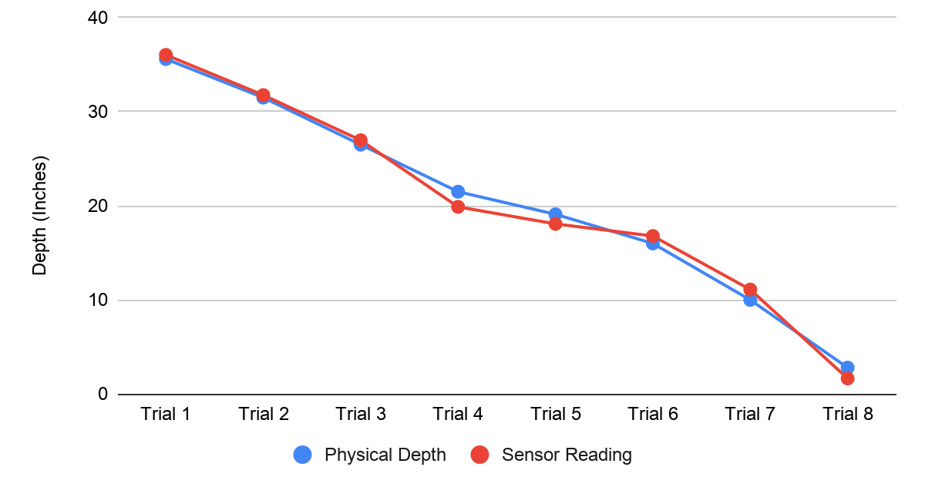
Winch Automation - Sensor Accuracy
Total average error rate was 0.94 inches.
Notes:
Yacer I’m just adding it here in case you want to talk about
-Will explain the accuracy of the sensor that
-mention that it was noticed that after long time of usage the sensor reading accuracy drop it needs to be reset ( restarting the software we created)
-
-

Slide 20
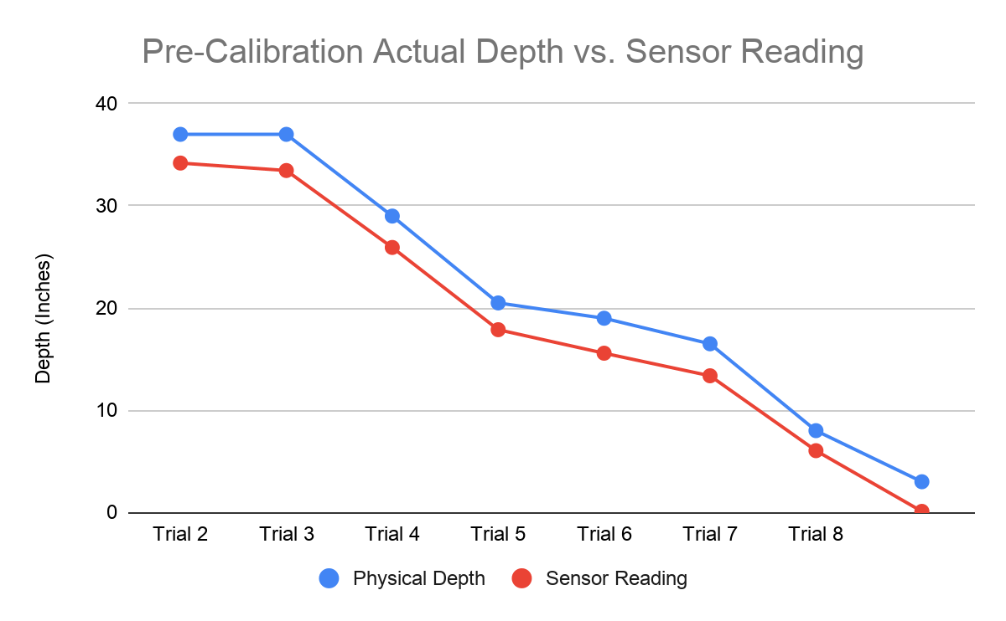
Winch Automation - Sensor Accuracy
After longer hours of use total average error rate was 2.89 inches.
Notes:
Yacer I’m just adding it here in case you want to talk about
After longer hours of use
-Will explain the accuracy of the sensor that
-mention that it was noticed that after long time of usage the sensor reading accuracy drop it needs to be reset ( restarting the software we created)
-
-

Slide 21
Dronekit Simulation
Physical Autonomous Surface Craft was not available for us to test.
Python dronekit was used to simulate movement of the Autonomous Surface Craft on Lake Lansing.
The Python script to control the simulation was run from the raspberry pi, and communicated to the host computer using MAVLink proxy.
The simulation code was then combined with the winch control code, so both could be run on a single script. This allowed us to put protection in the software to prevent the thrusters from operating at the same time as the winch.
Notes:
Paul Hanvey

Slide 22
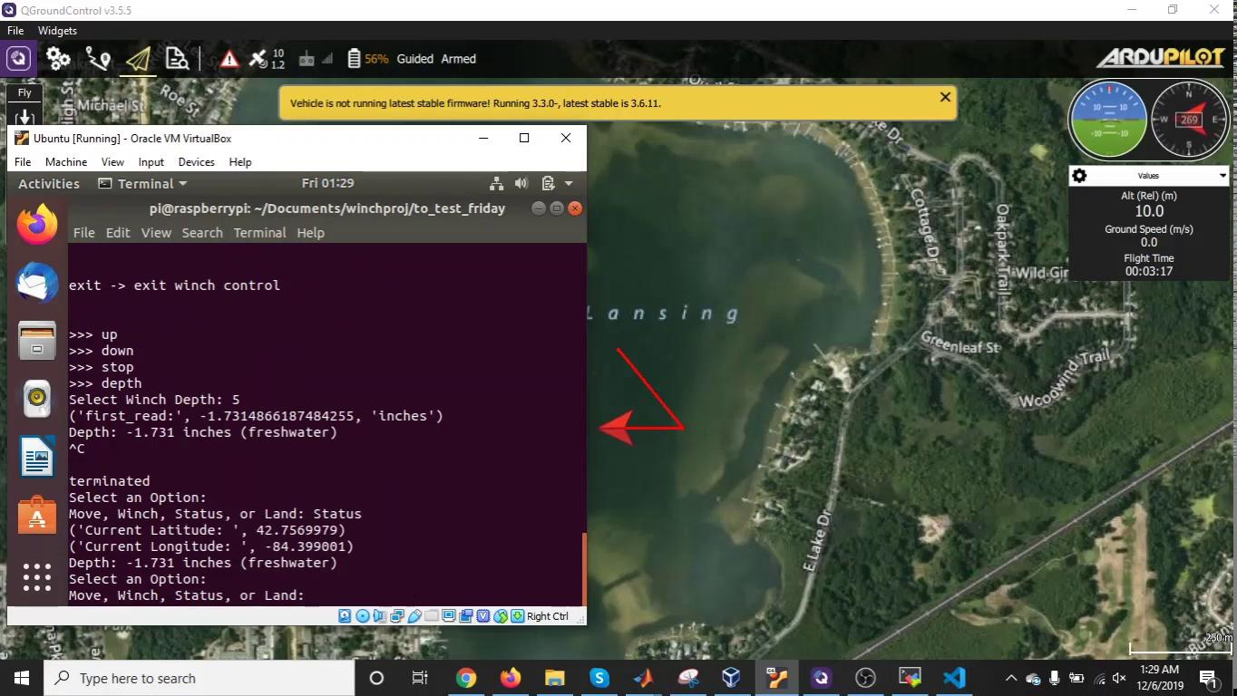
Dronekit Simulation Video Demonstration

Slide 23
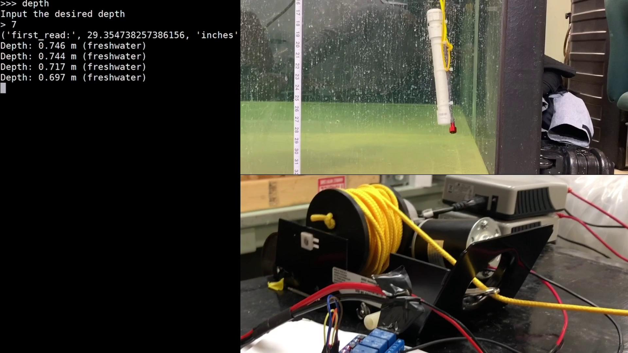
Video Demonstration
Notes:
Paul Hanvey

Slide 24
Initial Budget
Item: | Quantity: | Unit Cost: | Total Cost:
Raspberry Pi | 1 | $45 | $45
PixHawk | 1 | $123 | $123
Pressure Sensor | 1 | $68 | $68
Power Control PCB | 1 | $75 | $75
Photo-Optic Sensor | 1 | $20 | $20
Data Cable | 19 | $4.50 | $85.50
Project Cost: |  |  | $416.50
Notes:
Adam Chapman

Slide 25
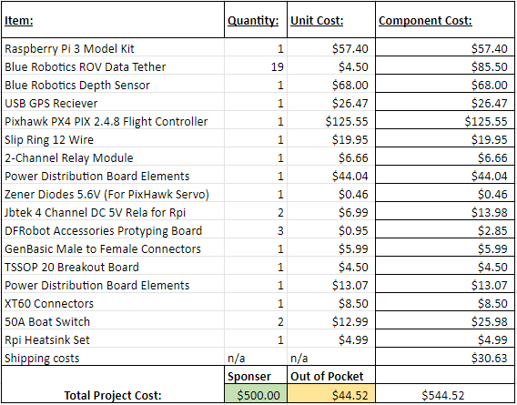
Final Budget
Success of budget
Flexibility
Pitfalls
Over Budget
Thoughts going forward
Budget subsections
Building, Testing
Redundancy
Notes:
Adam Chapman

Slide 26
Project Reflection
Things to be improved
Small team would be more beneficial for meeting learning objectives
Budget tracking
PCB Design
Major Accomplishments
Code development
Spool modification
Successful aspects
Project deliverables successful
Automated system which can provide depth sensing
Slip Ring Development
Team management dealt with appropriately
Overall Feeling: Successful

Slide 27

Future Work - Communication System
Currently, SSH tunneling is used for communication between the Raspberry Pi and host computer
In future, an XBee radio module could be used in place of IEEE 802.11 (WiFi)
XBee would have much greater range for field use of several miles [3]
Useful for field testing over large distances
Notes:
Parwesh

Slide 28
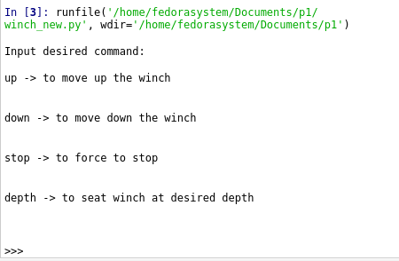
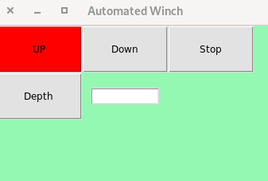
Future Work - Graphical User Interface & Data Log
Notes:
Funakoshi
Will explain GUI features to improve outdoor winch work /
In the long run it would be better to include in the GUI screen the real time reading of the sensor value. As of now the sensor values show on a different screen. Essentially it would be more practical to the user to manage all the work in one screen.
To improve ease of research an automated data logo should be included with the software.

Slide 29
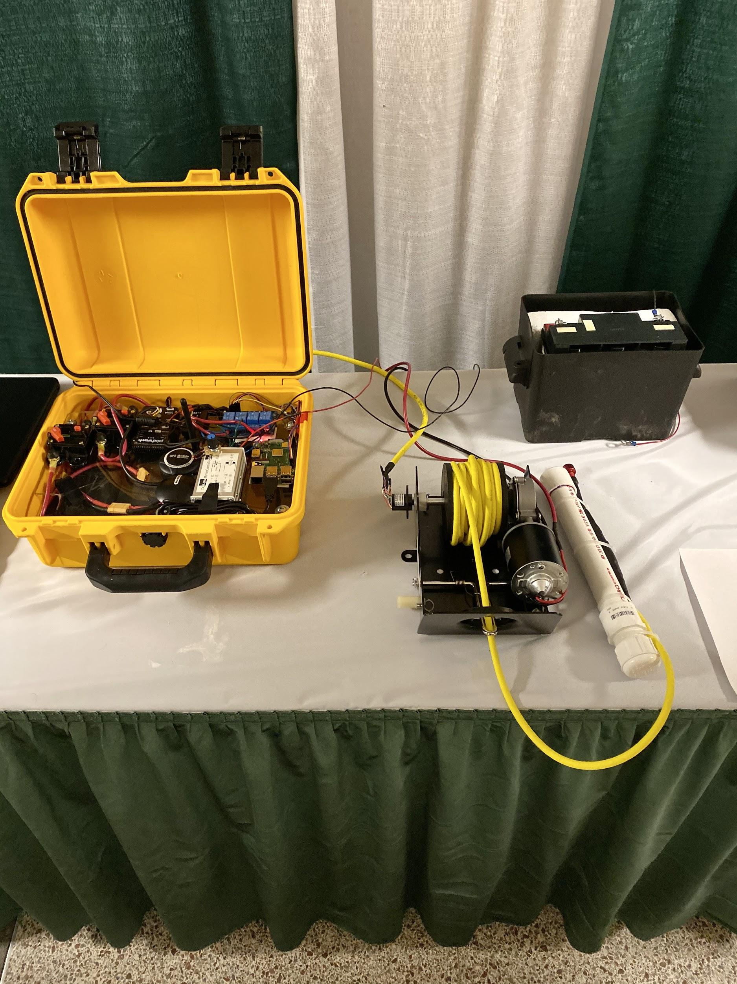
Conclusion
Problem Statement
Project Goals
Background
Prior Work
Objectives
Technical Details/Approach
Budget
Project Reflection
Future Work
Notes:
Adam

Slide 30
References
[1] Wikipedia contributors. (2018, November 27). Acoustic tag. In Wikipedia, The Free Encyclopedia. Retrieved 01:38, October 3, 2019, from https://en.wikipedia.org/w/index.php?title=Acoustic_tag&oldid=870802906
[2] https://github.com/bluerobotics/ms5837-python/blob/master/ms5837.py
[3] https://www.digi.com/products/embedded-systems/digi-xbee/rf-modules/sub-1-ghz-modules/xbee-pro-900hp
[4] https://www.slideserve.com/kalona/fluid-mechanics

Slide 31
Questions?

